Slide 1
A Convergence Study and Contributions to libCEED
CS 5636: Numerical Solutions to PDEs Final Project Presentation
Dec 7 2022
Leila Ghaffari, Amanda Shackelford, Joey Clement

Slide 2


libCEED
Open source numerical software library for finite element methods
Sparse matrices are expensive for high order methods
New format needed to represent operators
Goals of libCEED:
Implement a matrix free representation
Note: libCEED supports matrix methods for low order solvers
Enable efficient computation on different device types/architectures
[1] https://github.com/CEED/libCEED
Notes:
libCEED supports matrix methods as well for lower order

Slide 3
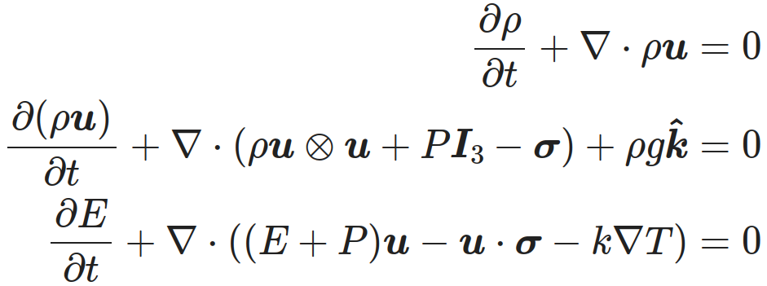




Navier Stokes Equations for Compressible Flow
Mass
Momentum
Total Energy
Conservative Variables
Primitive Variables
Primitives often easier to work with/more intuitive
Accuracy determined by application
Primitives are measurable

Slide 4
Navier Stokes Miniapp
Problems:
Advection
Rotation
Translation
Euler
Isentropic Vortex
Shock Tube
Navier-Stokes
Density Current
Channel
Blasius Boundary Layer
Synthetic Turbulence Generation
Features:
Stabilization Techniques
SU (streamline-upwind)
SUPG (streamline-upwind/Petrov-Galerkin)
Unstructured Mesh
Conservative and Primitive variables
Implicit and explicit time integration

Slide 5
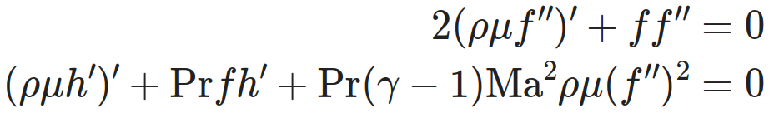
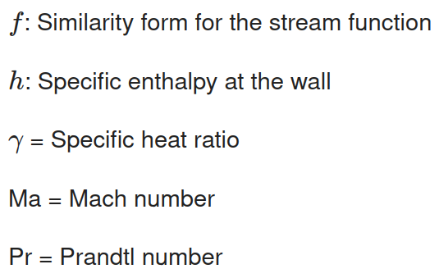
Blasius Problem Refresher
Two dimensional flow layer over a semi-infinite flat plate
Similarity transform essentially reduces to 1-D problem in distance from plate
0 < η < 1 describes the entire boundary layer at any x-coordinate
Self similar coordinate
Certain terms in NS equations negligible
Problem described by:

Slide 6
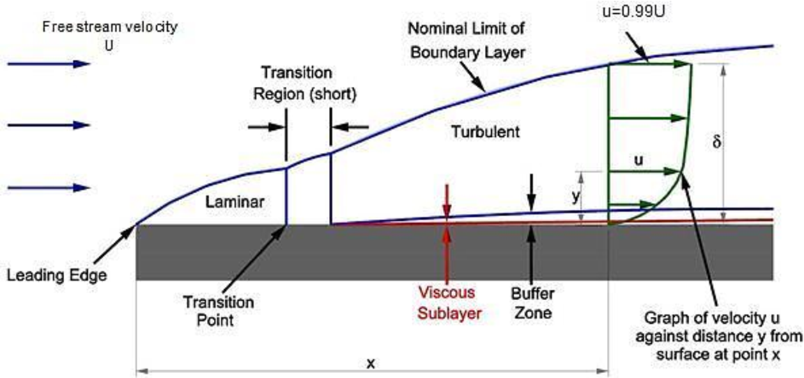
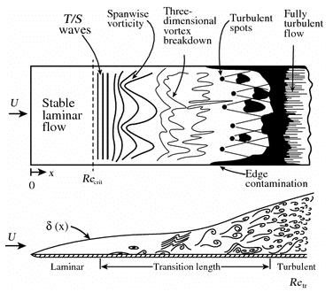
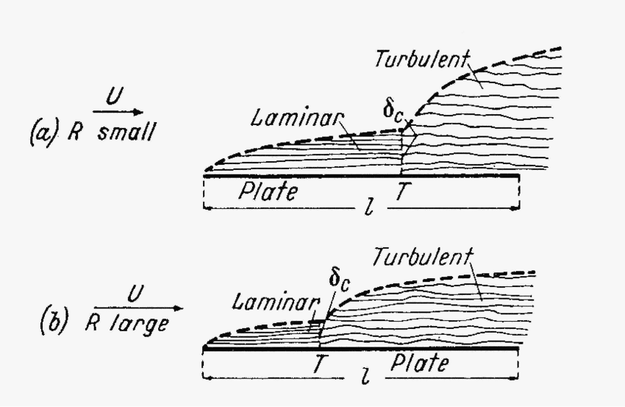
Blasius Boundary Layers
Boundary layers form as a fluid moves over a flat plate:
At the leading edge of the plate, there is a laminar region. As the flow continues back from the leading edge, the laminar boundary layer increases in thickness.
A Turbulent layer is eventually reached and a viscous sublayer is formed.
Many things affect the length of these regions both along and away from the plate
Notes:
Care
Leading edge
Turbulent
modeling

Slide 7
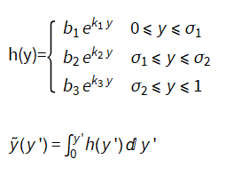
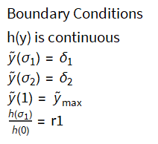
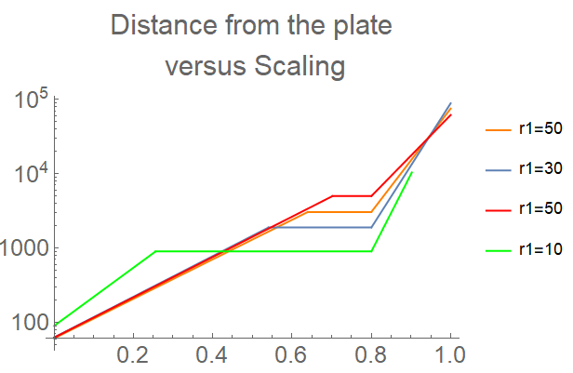
Mesh Generation
Problem Formulation
Goal: Come up with a continuous transformation that has all of the information you would like to specify to generate the mesh.
What we would like to be able to specify:
Aspect ratio at the first boundary between the viscous region and the turbulent region
Height of the two layers and total height of the domain
Percentage of total height to the second boundary layer (in decimal form)
Vary the aspect ratio, set y₁=10, y₂=500, y_{max}=5000, σ₂=0.8
Notes:
Contribution/goal
Problem formulation
tested

Slide 8
Contributions to libCEED
Output errors from NS solver in both primitive and conservative variables
Previously only 2D Advection and Euler solvers computed errors
NS solver now computes errors for exactly solvable problems
Errors computed for one set of variables (primitive or conservative)
In post processing, converts errors into other set, report both
Update mesh generation to make user input more friendly
Previously the mesh was generated discretely from changing the setting in the yaml file (for changing from linear to quadratic) and specifying the number of nodes
Now the mesh will be generated from a continuous function so can easily convert before linear and quadratic mesh
Functional form provides a more intuitive input for users who know what boundary layers they want to resolve
Convergence study on Blasius boundary layer problem

Slide 9
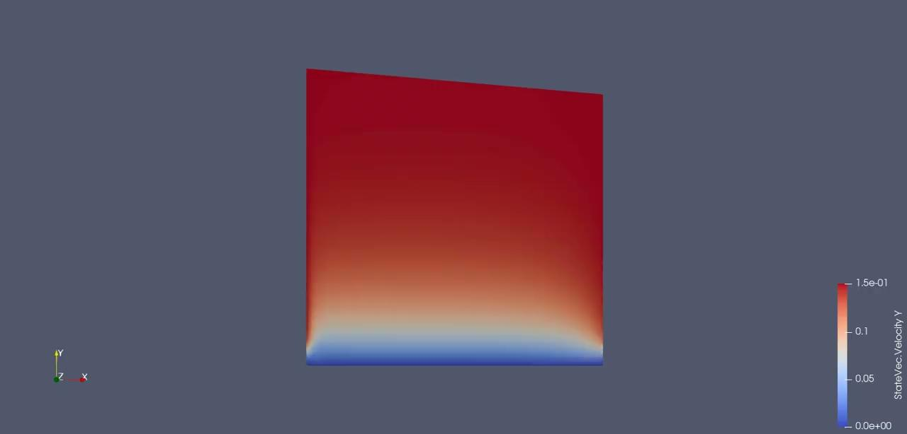

Blasius Problem With Primitive And Conservative Variables
Problem run in primitive variables
Problem run in conservative variables

Slide 10
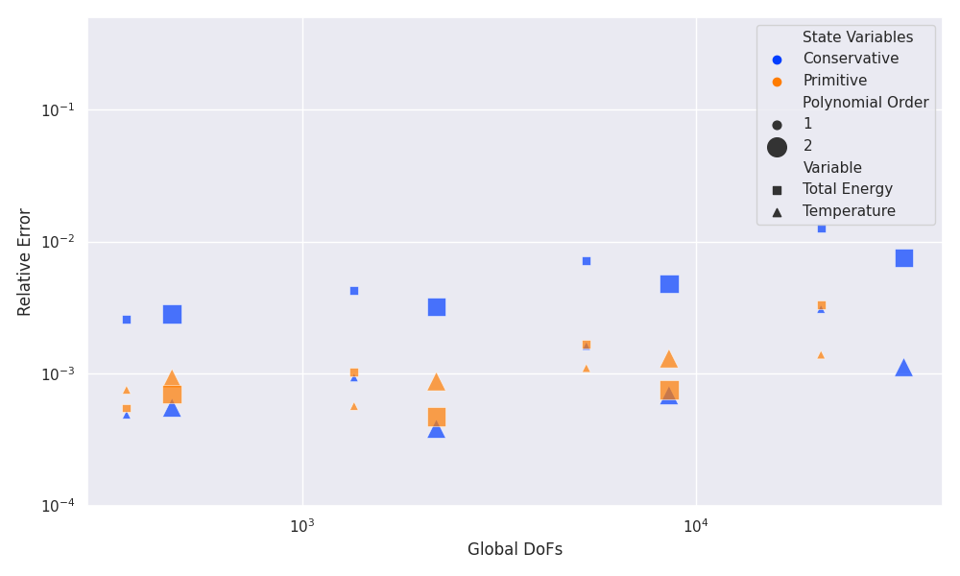
Convergence (?) study

Slide 11
Current State
Open PRs:
Automate stabilization coefficients https://github.com/CEED/libCEED/pull/1096
Compute component-wise errors in primitive and conservative variable sets https://github.com/CEED/libCEED/pull/1109
Automate mesh generation for the boundary layer https://github.com/CEED/libCEED/pull/1111
Outlook:
Investigate the issue with the convergence plot
Incorporate the entropy variables implemented by Zach and Drishan
Perform similar study for other ICs and BCs

Slide 12
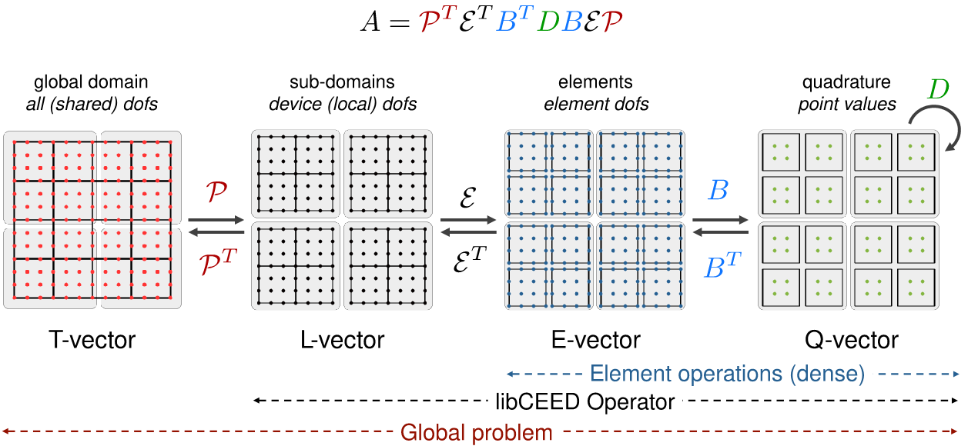
[2] https://libceed.org/en/latest/libCEEDapi/#finite-element-operator-decomposition

